Slide 1
NNFL ASSIGNMENT
2017A8PS0420P – ANUJ HYDRABADI
2017A3PS0232P – ANSHUL GARG
2017A7PS0184P – TANMAY MOGHE

Slide 2
Problem Statement
Training recurrent networks to generate hypotheses about how the brain solves hard navigation problems
SLAM – Simultaneous Location and Mapping
Our main task is self-localization during navigation with inputs from noisy sensors. Usually, SLAM-algorithms such as path integration, Bayesian estimator are employed to solve this task.
Our network is a solution to this problem and it uses a recurrent LSTM structure.

Slide 3
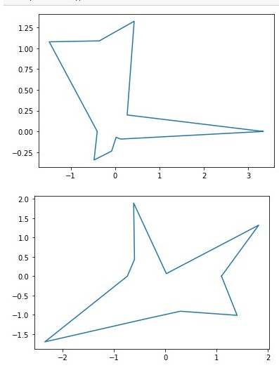
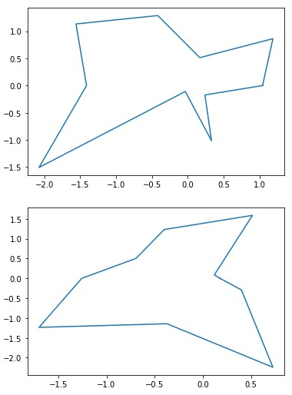
Simulating the Environment
Step 1 : Generating random 10-sided polygons.
r = length of side (sampled using normal distribution - mean 1m and standard deviation also 1m)
Points are of form (r,n*pi/10) (n is from 0 to 9)

Slide 4
Simulating the Environment
Step 2 : Selecting a random point inside the polygon.
Step 3 : Giving a random velocity (magnitude and direction) from the above random point.
Speed was always held constant at 0.01m/s. The random angle was between 0 and 2*pi (0,6.28). The network was provided with noisy input by adding Gaussian noise to speed (mean = 0, sd = 0.001) and angle (mean = 0, sd = 1).

Slide 5
Simulating the Environment
Step 4 – On every collision with the borders of a polygon, the rat changes its direction (assuming total internal reflection) and goes on until the next collision. This process is repeated until required.
Input is given for each collision (each of them noisy)–
Velocity (magnitude + direction) – noise specified earlier
Time Stamp of Collision
Boundary contact information at each collision - length of boundary (gaussian noise – mean = 0, sd = 0.01) and relative angle of collision (gaussian noise – mean = 0, sd = 0.5).
Relative angle of collision is between o and pi.

Slide 6
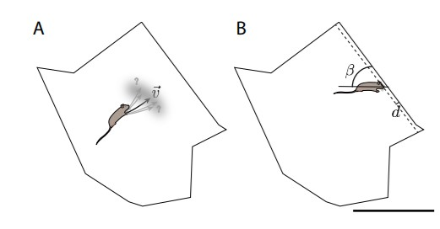
Simulating the environment

Slide 7
Final Dataframe
This is an X x Y x Z array.
X = the number of trials
Y = the number of collisions in each trial (time series data)
Z = number of features to be returned for each collision.

Slide 8
Structure of the Network
Layer 1 : Input layer
Layer 2 : Hidden LSTM layer with 256 LSTM units
Layer 3 : Output layer, varies depending on the task performed.
Network is trained using Adam’s Algorithm.

Slide 9
Task 1 - Localization
Localization in a single familiar environment.
The rat is familiar with the geometry of the environment (coordinates of the polygon also given as input) but starts each trial at a random unknown location.
The output of the network is the initial position of the rat (x,y).
The network was given 5000 training samples and was validated on a separate set of 1000 samples. Each of the sample involved data for 6 collisions.
Error – Mean Squared Error
Output in Activation – Linear Readout

Slide 10
Result of Task 1
Accuracy (on validation data set) for task 1 with noisy inputs( gaussian noise) for velocity, d and beta was 87.6%.
Accuracy (on validation data set) for task 1 with noisy inputs( gaussian noise for velocity and 100% error with probability 0.01 for d and beta) was 88.3%.

Slide 11
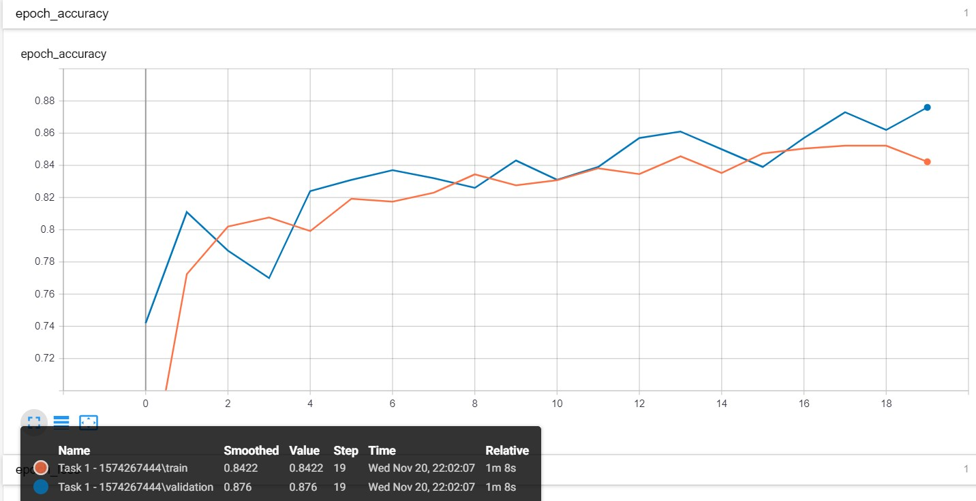
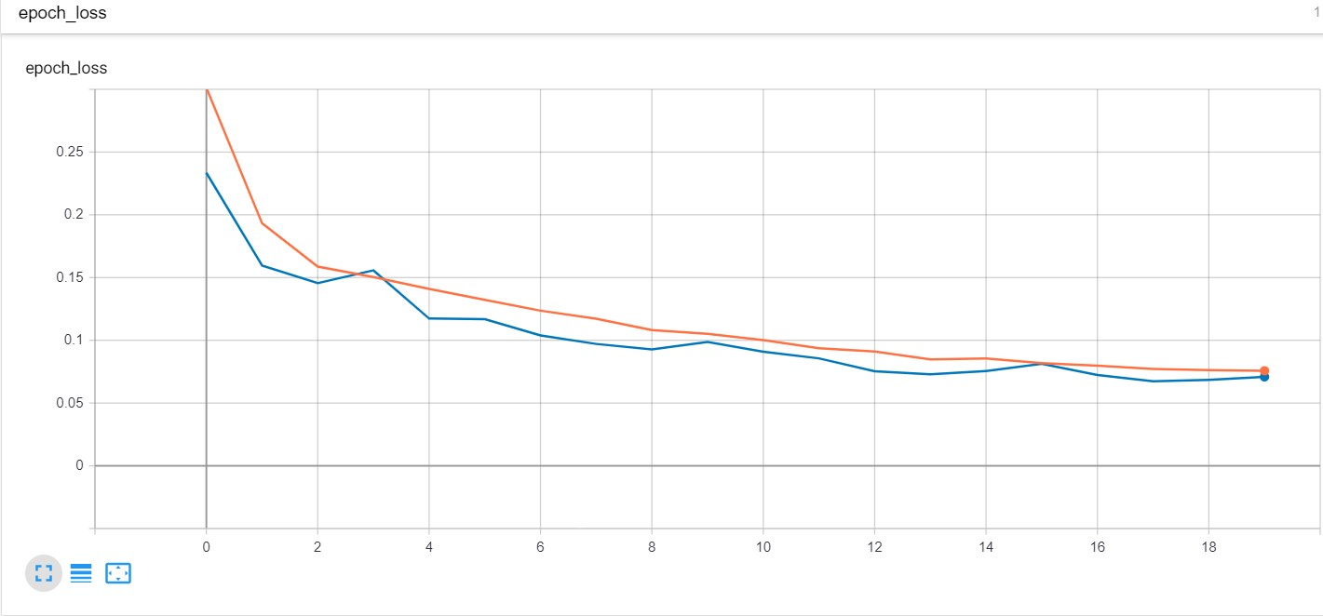

Slide 12
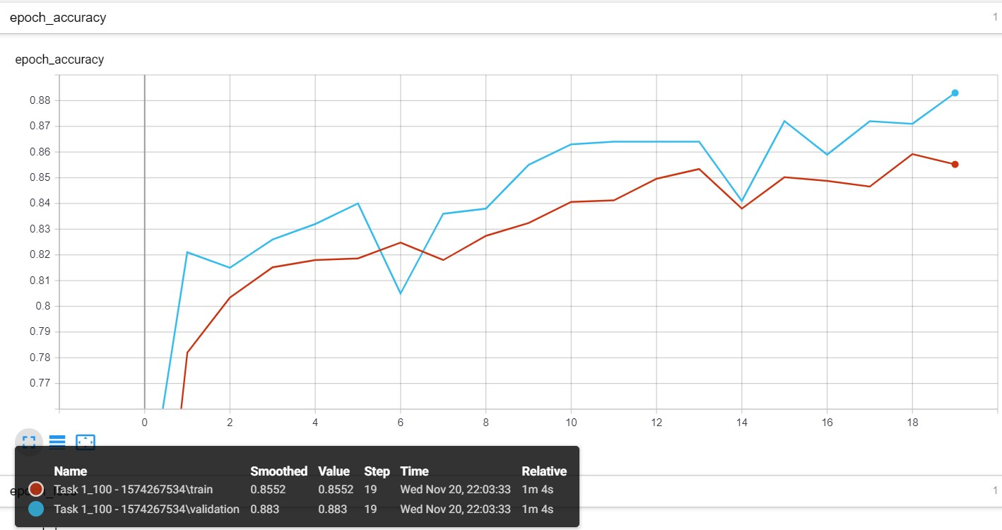
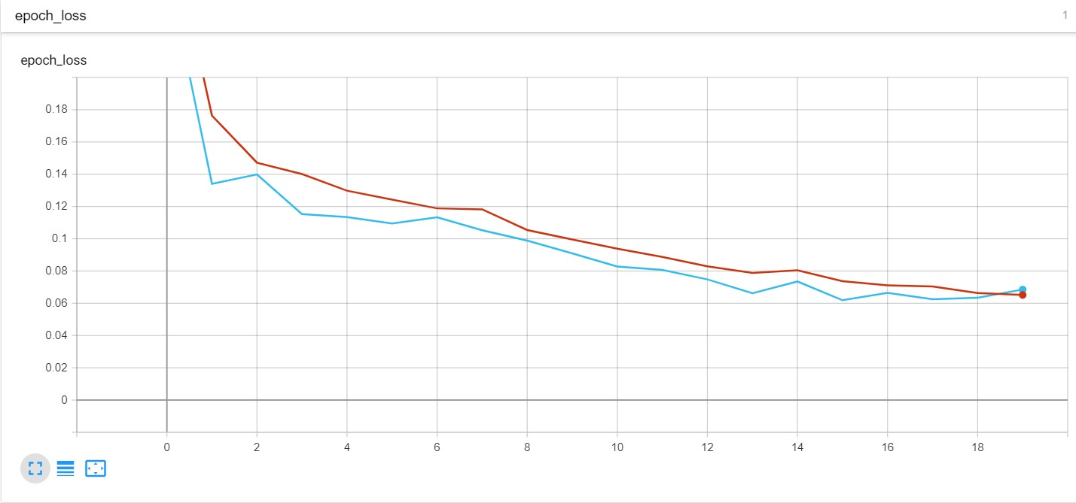

Slide 13
Task 2 – Generalized SLAM
Localization in novel environments.
The inputs to the network are the same as in task 1 except the coordinates of the polygon as the rat is not aware of the geometry of the polygon.
The output of the network is the initial position of the rat (x,y).
The network was given 200000 training samples (novel polygons) and was validated on a separate set of 1000 samples. Each of the sample involved data for 20 collisions.
Error – Mean Squared Error
Output in Activation – Linear Readout

Slide 14
Result of Task 2
Accuracy (on validation data set) for task 2 with noisy inputs (gaussian noise) for velocity, d and beta was 80.5%.
Accuracy (on validation data set) for task 2 with noisy inputs (gaussian noise for velocity and 100% error with probability 0.01 for d and beta) was 81.8%.
Training on a dataset with 10 collisions (for each sample) resulted in an accuracy of 68.4%.

Slide 15
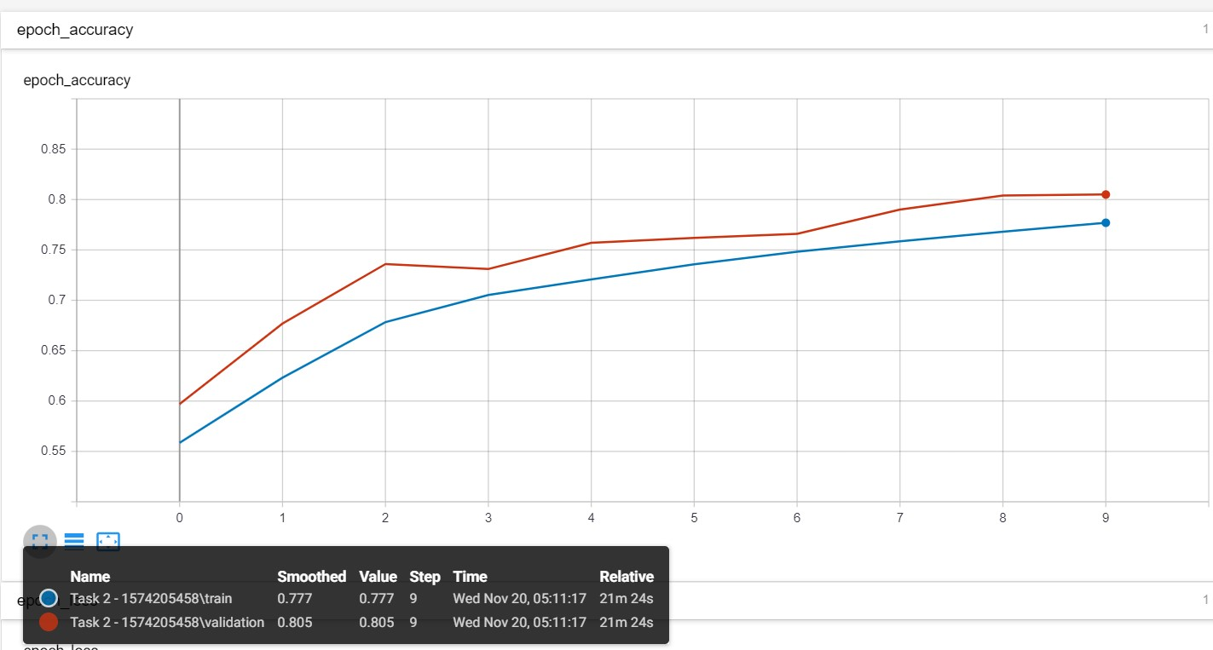
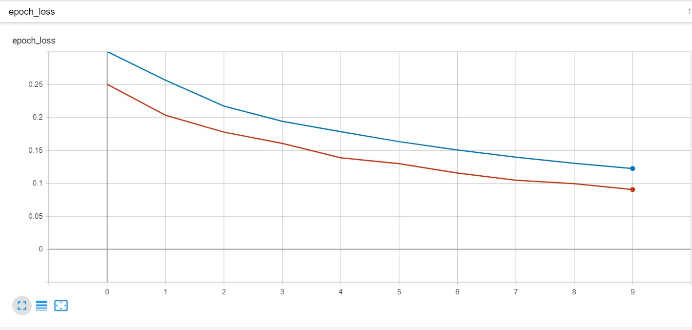

Slide 16
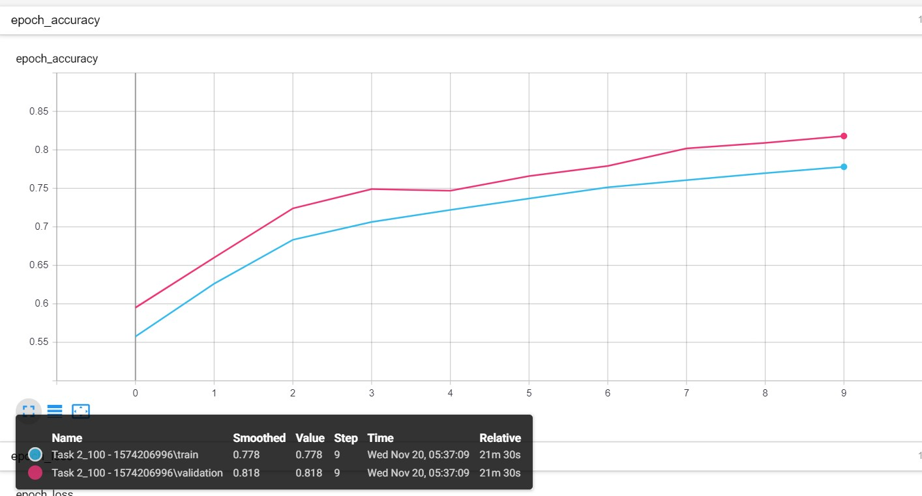
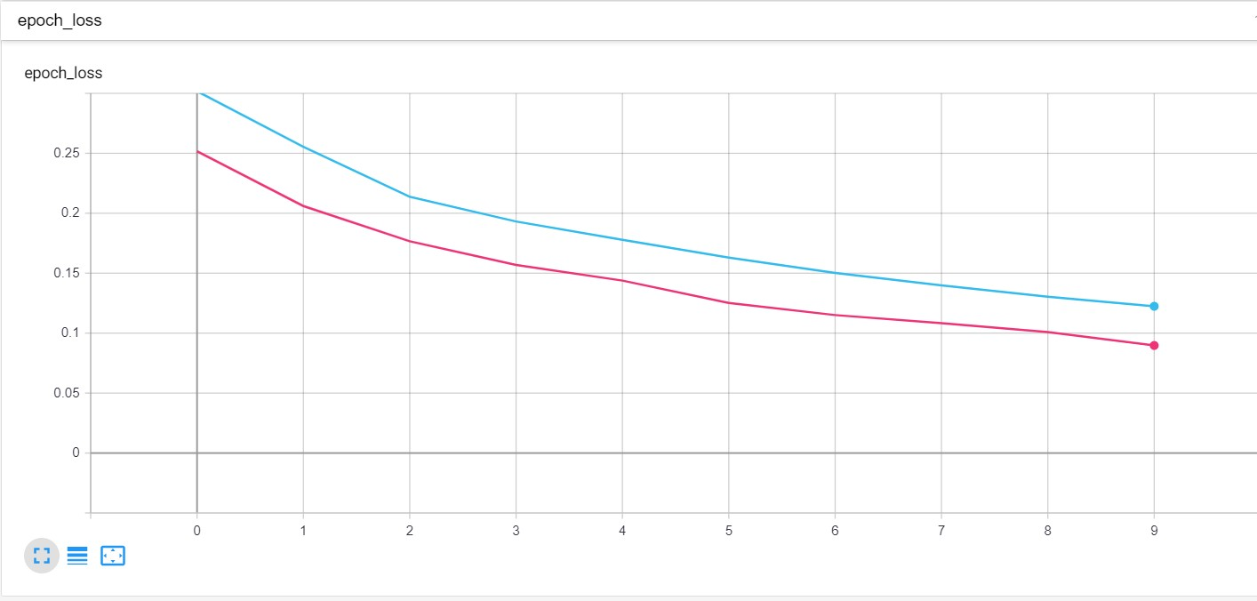

Slide 17
Task 3 – Specialized Task
The rat is placed in one of 100 known environments. Its task is to identify (classify) the polygon it is placed in.
The input is same as task 2.
The output of the network is a one hot encoded layer of size 100 with each output node corresponding to one of the 100 polygons.
The network was given 199000 training samples and was validated on a separate set of 1000 samples. Each of the sample involved data for 20 collisions.
Error – Cross Entropy
Output in Activation – Softmax

Slide 18
Result of Task 3
Accuracy (on validation data set) for task 3 with noisy inputs (gaussian noise) for velocity, d and beta was 96%.
Accuracy (on validation data set) for task 3 with noisy inputs (gaussian noise for velocity and 100% error with probability 0.01 for d and beta) was 97.8%.

Slide 19
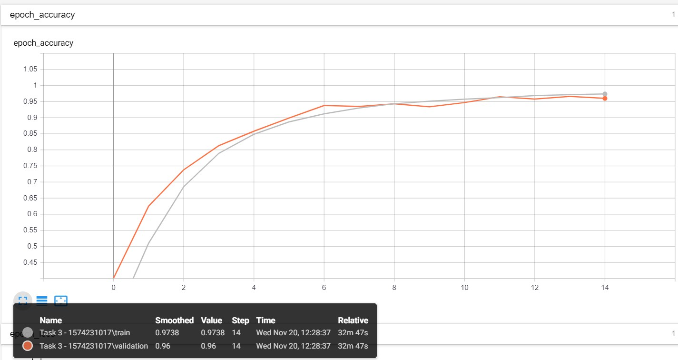
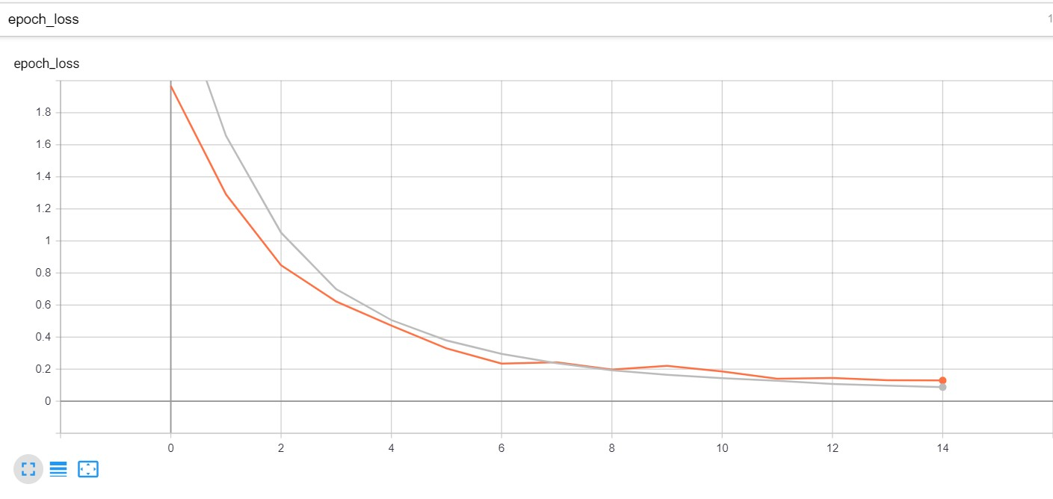

Slide 20
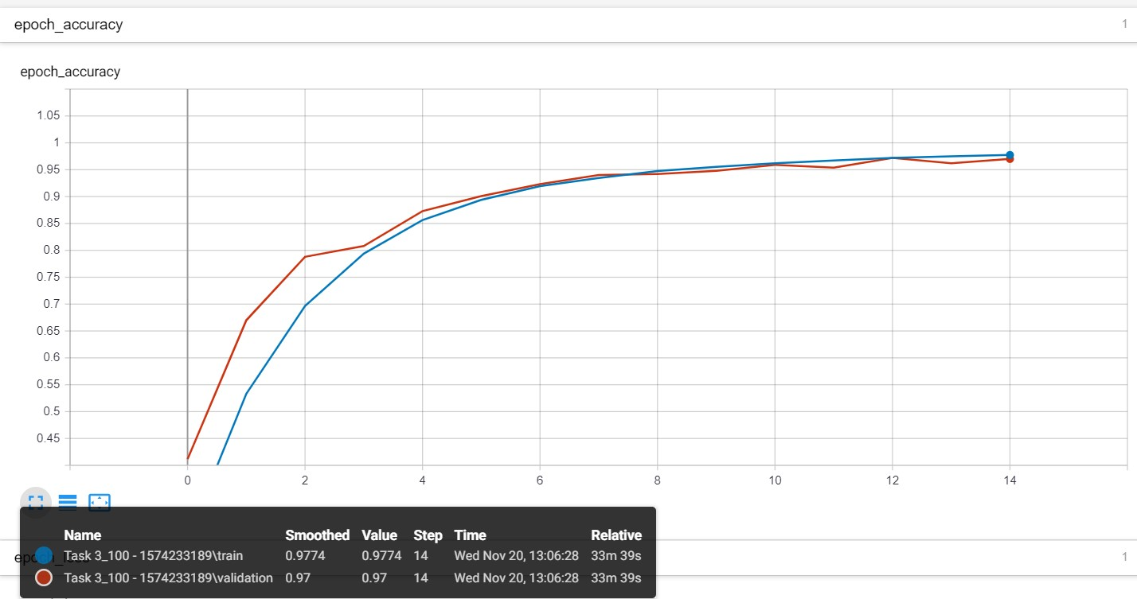
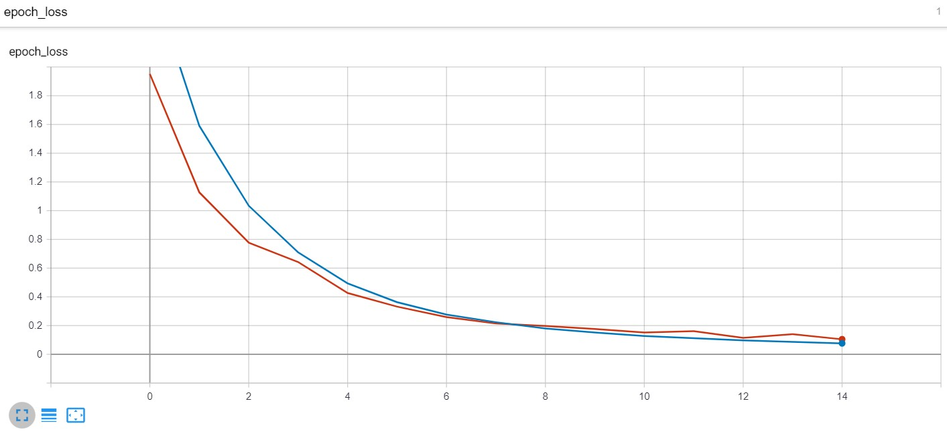

Slide 21
Task 1 - Supplemental Information
Measure of d was changed to distance from nearest vertex instead of length of line segment.
Accuracy (on validation data set) for task 1 with noisy inputs( gaussian noise) for velocity, d and beta was
Accuracy (on validation data set) for task 1 with noisy inputs( gaussian noise for velocity and 100% error with probability 0.01 for d and beta) was

Slide 22
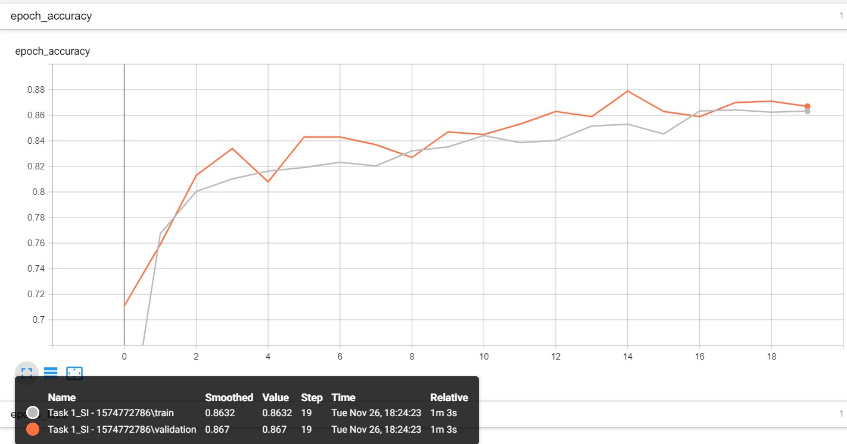
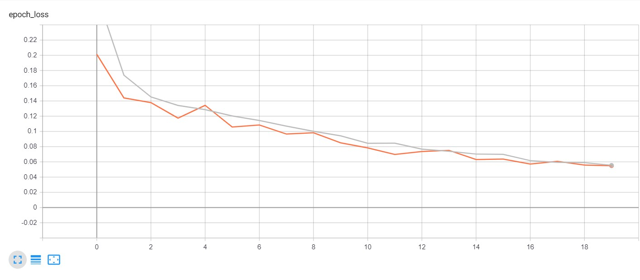

Slide 23
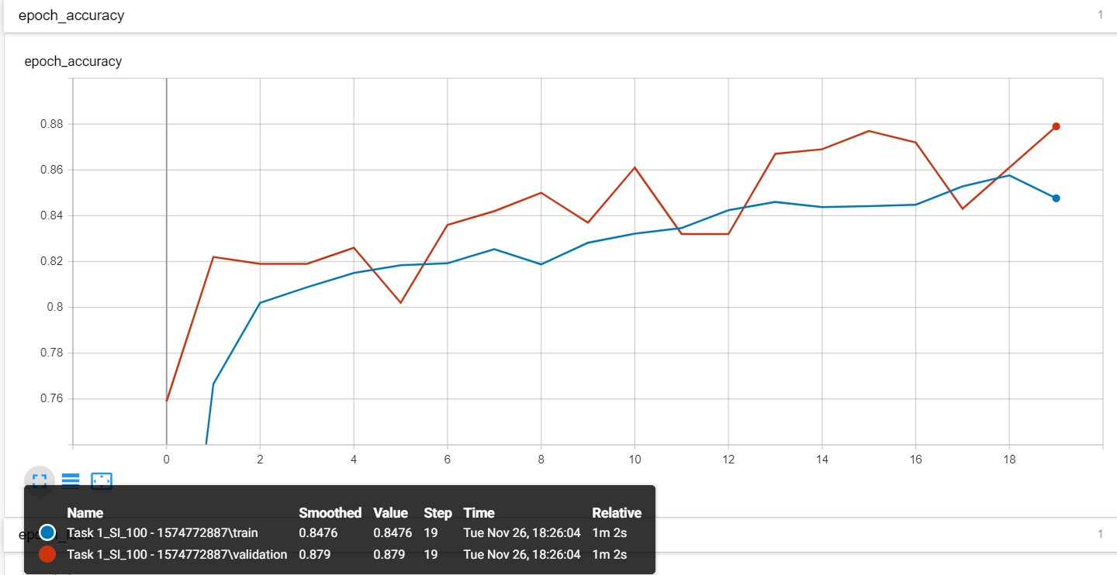

Slide 24
THANK YOU

